Slide 1
Predicting the Sales Value of products
By: Zindazed Kasauli - 2024/HD05/21948U Nakayiza Shamim - 2024/HD05/21950U

Slide 2
Background
In today's competitive business landscape, sales prediction is vital for informed decision-making and strategic resource allocation. Our client, seeking to maximize sales, has provided transactional data spanning various sales channels, regions, and product categories. We have so far developed a Dashboard with graphs showing realtime trends in the transactions. Recognizing the potential of machine learning (ML) in predicting sales values, this project aims to develop a regression model that predicts sales value to enhance data-driven decision-making.

Slide 3
Objective
The primary objective of this project is to develop a regression model that predicts sales value, basing on various factors such as product category, region, and sales channels.

Slide 4
Literature Review
Predictive analytics plays a crucial role in optimizing sales by enabling businesses to make data-driven decisions. In retail, it helps anticipate customer needs, optimize inventory, and improve personalized marketing, leading to increased sales and customer satisfaction (Debutify, 2023). AI enhances this by automating data analysis, allowing sales teams to focus on high-probability prospects and adjust strategies in real-time (Center for Sales Strategy, 2023). Predictive sales analytics further enables forecasting outcomes and optimizing employee performance, ensuring the right products are sold through the most effective channels (Pecan AI, 2023). These tools help businesses allocate resources effectively and increase revenue (Sales-i, 2023).

Slide 5
Problem Statement
Despite having access to transactional data, our Client struggles to predict sales value, leading to suboptimal resource allocation, and missed revenue opportunities. Current forecasting methods rely heavily on intuition and historical averages, failing to account for complex interactions between product categories, regions, and sales channels.

Slide 6
Data
Data Collection:
The dataset was collected from a client’s business sales transactions over a year. It contains records of sales channels, regions, products Categories, allowing for comprehensive analysis of how different factors contribute to overall sales.
Target Variable: Sales Value (continuous)
Predictor Variables: Product Category (categorical), Region (categorical), Channel (categorical)
Size: 7499 entries
Type of learning: Regression

Slide 7
Data Wrangling
The dataset underwent extensive cleaning and preparation. Initially, missing values were identified and addressed, with the 'Product Category' column filled with 'Unknown' where necessary. Negative and zero values in the 'Sales Value' column were detected and removed, resulting in a filtered dataset with positive sales values only. A logarithmic transformation was applied to 'Sales Value' to create 'log_sales_value'. One-Hot Encoding was employed on categorical columns ('Region', 'Channel', 'Product Category') to facilitate regression analysis. Subsequently, variance inflation factors (VIFs) were calculated to detect multicollinearity, leading to the removal of highly correlated features. After recalculating VIFs, the refined dataset exhibited reduced multicollinearity, ensuring a more robust foundation for subsequent modeling.

Slide 8
Research Questions
What are the key drivers of sales value amongst regions, channels, and product categories?
How accurately can we predict sales value based on given features?
Which models provide the most accurate and interpretable predictions?

Slide 9
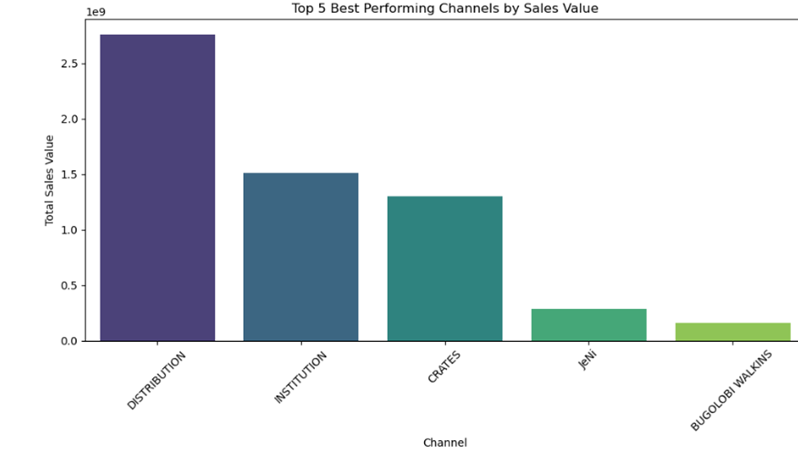
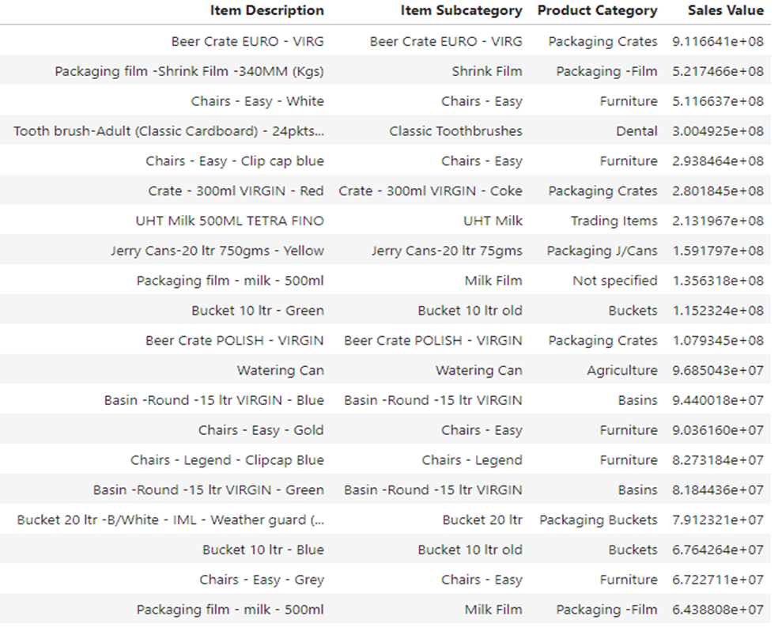
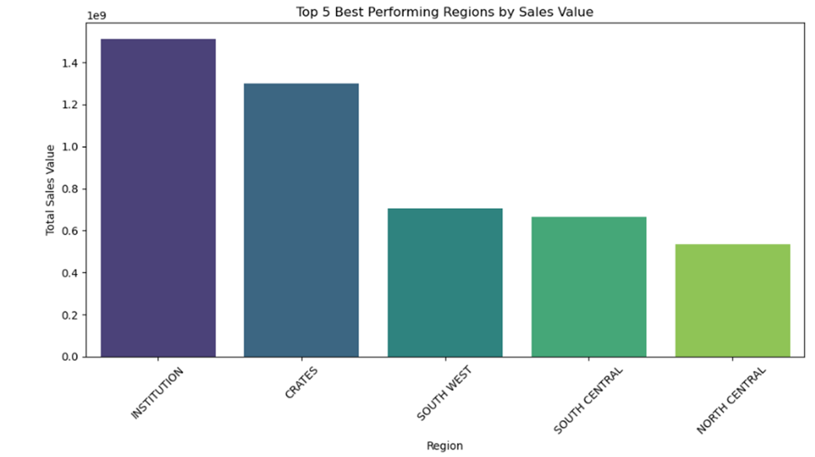
Exploratory Data Analysis
20 Best Selling Products

Slide 10
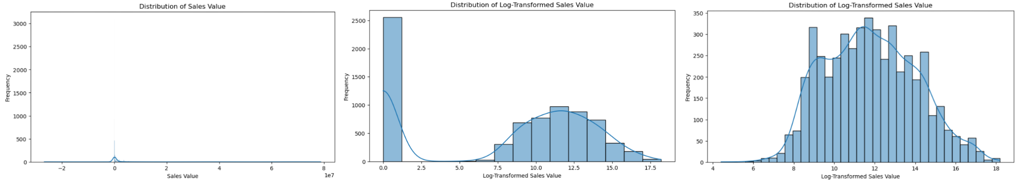
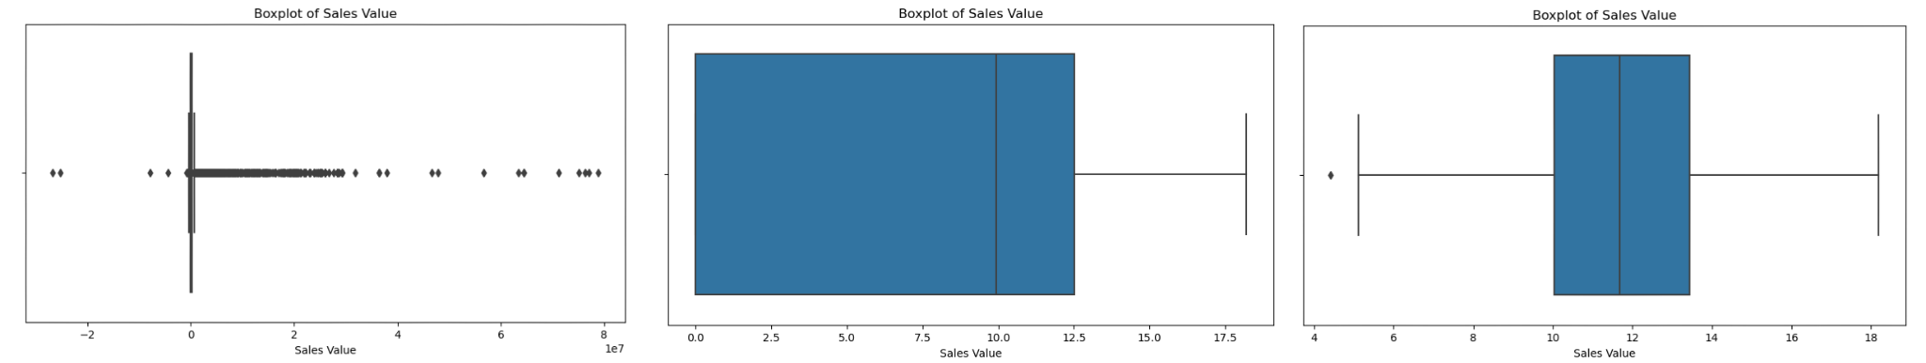
Exploratory Data Analysis - Data transformation

Slide 11
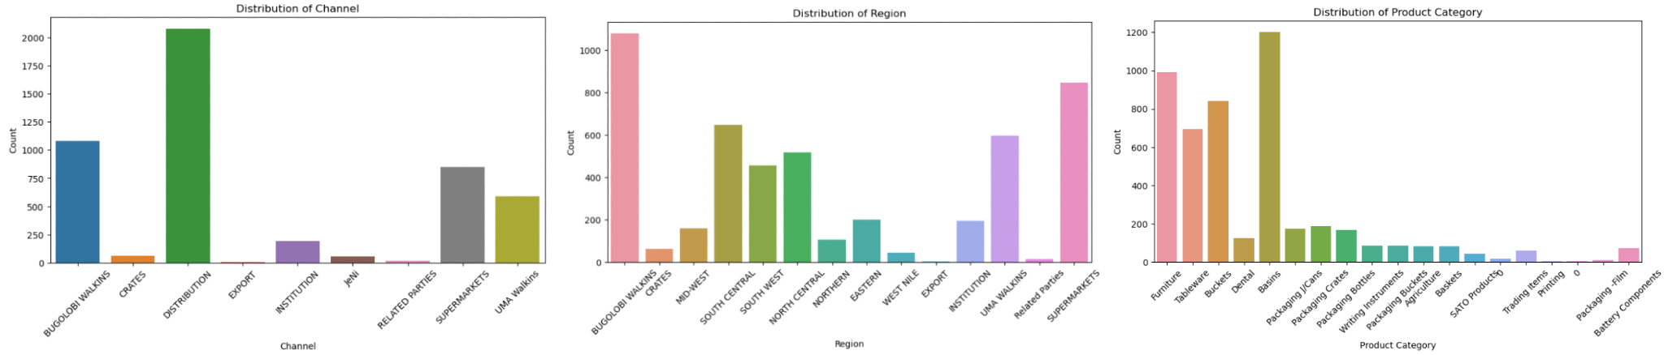
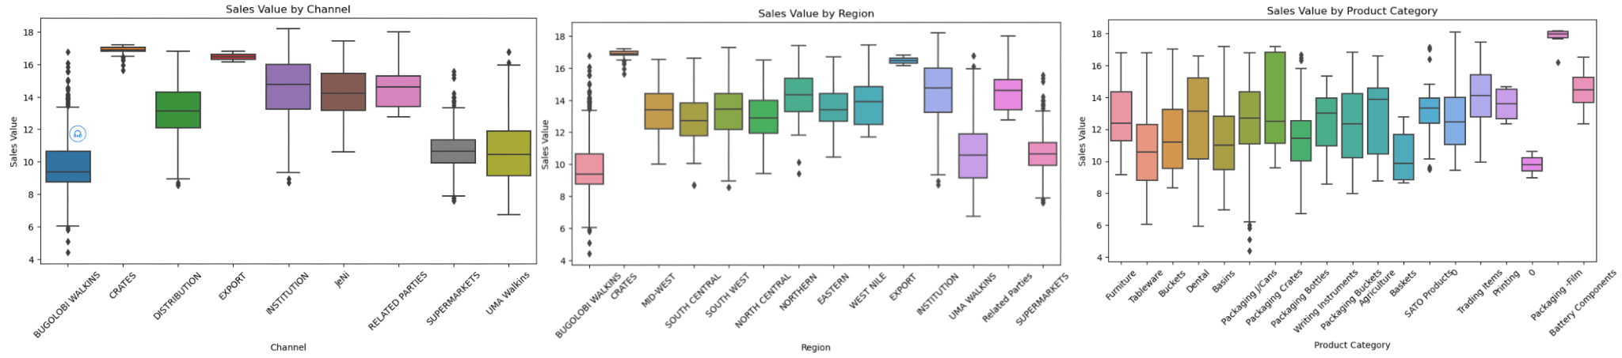
Exploratory Data Analysis

Slide 12
Linear Regression
Dataset | R-squared | Mean Absolute Error | Root Mean Square Error
Training | 0.681 | 0.964 | 1.268
Testing | 0.652 | 0.995 | 1.291
Linear regression performs consistently on both training and testing sets, with only a minor reduction in R-squared. The errors (MAE and RMSE) are close between the training and testing sets, indicating a reasonable fit and good generalizability.

Slide 13
Random Forest
Dataset | R-squared | Mean Absolute Error | Root Mean Square Error
Training | 0.730 | 0.870 | 1.166
Testing | 0.676 | 0.947 | 1.246
Random forest performs better than linear regression in both fit (higher R-squared) and prediction accuracy (lower MAE and RMSE). It captures more complex relationships, providing a more accurate prediction overall without substantial overfitting.

Slide 14
Lasso Regression
Dataset | R-squared | Mean Absolute Error | Root Mean Square Error
Training | 0.176 | 1.661 | 2.038
Testing | 0.151 | 1.656 | 2.016
significantly underperforms both linear regression and Random Forest. Its low R-squared and high errors suggest it is not capturing the relationships effectively

Slide 15
Conclusion
Model | R-squared | Mean Absolute Error | Root Mean Square Error
Linear Regression | 0.681 | 0.964 | 1.268
Random Forest | 0.730 | 0.870 | 1.166
Lasso Regression | 0.176 | 1.661 | 2.038
Out of the three models used, random forest is the most effective model for this dataset, providing a good balance between fit and predictive accuracy, followed by linear regression for simpler use cases. Lasso regression is not recommended due to poor performance.

Slide 16
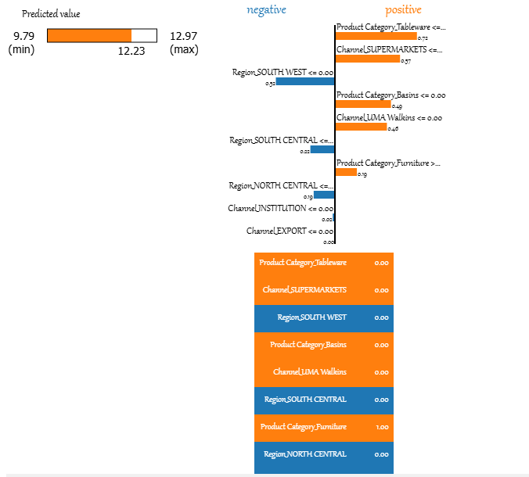
Explainable AI - Lasso Regression model - LIME
The model predicted a relatively high log-transformed sales value for this instance (12.23).
The main features pushing the prediction higher are the product categories like Tableware and Basins and channels like SUPERMARKETS.
Certain regions like SOUTH WEST and SOUTH CENTRAL are features that decrease the predicted value.

Slide 17
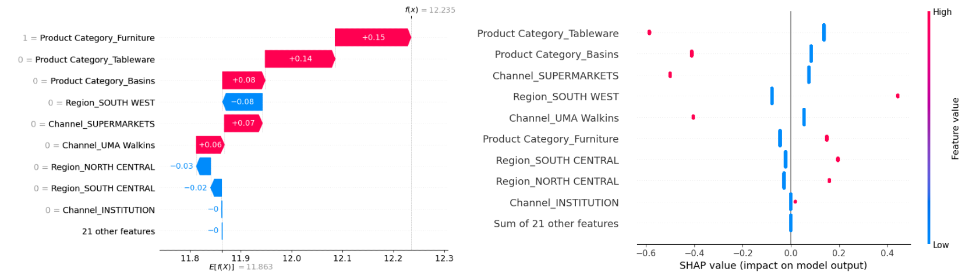
Explainable AI - Lasso Regression model - SHAP
The visualization reveals key drivers of the model's predictions through two plots. The waterfall plot(Left) shows that the average model output (11.863), Final prediction: f(x) = 12.235 and is positively impacted by Product Category (Furniture, Tableware, Basins), Channel (SUPERMARKETS, UMA Walkins), and negatively impacted by Region (SOUTH WEST, NORTH CENTRAL, SOUTH CENTRAL). The beeswarm plot (right) confirms that Product Categories have the strongest positive impact, while Regional features tend to have negative or mixed effects. Channel types, particularly SUPERMARKETS, show consistent positive influence. The top 8-9 features dominate the model's predictions, with minimal individual impact from the remaining 21 features. These insights highlight the complex interplay of factors driving the model's predictions.

Slide 18
LIME and SHAP comparison
Both identify the same key features as important:
Product categories (Furniture, Tableware, Basins)
Channel types (SUPERMARKETS, UMA Walkins)
Regional features (SOUTH WEST, SOUTH CENTRAL, NORTH CENTRAL)
Both show similar predicted values:
SHAP: 12.235
LIME: 12.23

Slide 19
Future Works
Deploy the Model.
Maintain the Model.

Slide 20
References
Debutify. (2023). Predictive Analytics in Retail: How Data Can Drive Sales. Retrieved from https://debutify.com/blog/predictive-analytics-in-retail
The Center for Sales Strategy. (2023). The Role of AI in Sales Strategy. Retrieved from https://blog.thecenterforsalesstrategy.com/the-role-of-ai-in-sales-strategy
Pecan AI. (2023). Elevate Your Game: The Role of Predictive Sales Analytics. Retrieved from https://www.pecan.ai/blog/elevate-your-game-the-role-of-predictive-sales-analytics
Sales-i. (2023). 6 Benefits of Predictive Analytics. Retrieved from https://www.sales-i.com/blog/6-benefits-of-predictive-analytics

